Slide 1
Classification Model

Slide 2
Project Overview
This project uses machine learning classification algorithms to predict whether a hotel booking will be canceled. The goal is to identify booking patterns associated with cancellations and evaluate how well different classification models can distinguish between canceled and non-canceled reservations.

Slide 3
Raw Data Set
Original dataset shape: (119390, 32)
Column List
1.Hotel
2.is_canceled
3.lead_time
4.arrival_date_year
5.arrival_date_month
6.arrival_date_week_number
7.arrival_date_day_of_month
8.stays_in_weekend_nights
9.stays_in_week_nights
10.Adults
11.Children
12.Babies
13.meal
,
14.Country
15.market_segment
16.distribution_channel
17.is_repeated_guest
18.previous_cancellations
19.previous_bookings_not_canceled
20.reserved_room_type
21.assigned_room_type
22.booking_changes
23.deposit_type
24.Agent
25.company
26.days_in_waiting_list
27.customer_type
28.Adr
29.required_car_parking_spaces
30.total_of_special_requests
31.reservation_status
32.reservation_status_date']
27,841 rows × 9 columns
Fully typed (categoricals, ordered categoricals for age & experience) — zero remaining nulls.
2021 Salary Survey — Key Points
3

Slide 4
Ready Data Set into Machine Learning Data Set

Slide 5
1
Load Data Set
2
Remove Duplicate
3
Remove target columns Leakage
Handle Missing Values
4
Children = 0
Country = unknown
Agent = 0
Company = drop, so many missing values
5
Standard meal category
BB, FB, HB, SC, Undefined change into SC
More experience reliably means more pay — up to a point, after which it plateaus.
2021 Salary Survey — Key Points
4

Slide 6
6
Filter Extreme Records / Record that is impossible
Has_guest = Total_guest > 0
has_nights = total_nights > 0
valid_adr_minimum = adr = 0
valid_adr_maximum = adr <= 1000
Drop/Condition not satisfied = 759 rows
7
New Features / Additional Columns
total_nights = weekend nights + weekday nights.
total_guests = adults + children + babies.
has_kids = 1 if children or babies are present, otherwise 0.
arrival_month month name converted to a number from 1 to 12.
arrival_weekday = day of week, where Monday = 0 and Sunday = 6.
adr_per_guest = average daily rate divided by total guests.
has_prev_cancel = 1 if the customer has any previous cancellations, otherwise 0.
TAKEAWAY
More experience reliably means more pay — up to a point, after which it plateaus.
2021 Salary Survey — Key Points
4

Slide 7
Filter Extreme Records / Record that is impossible
8
Has_guest = Total_guest > 0
has_nights = total_nights > 0
valid_adr_minimum = adr = 0
valid_adr_maximum = adr <= 1000
Drop/Condition not satisfied = 759 rows
9
Final Check and Save Data Set
Final dataset shape: (86637, 34)
TAKEAWAY
More experience reliably means more pay — up to a point, after which it plateaus.
2021 Salary Survey — Key Points
4

Slide 8
Machine learning python (Classification)

Slide 9
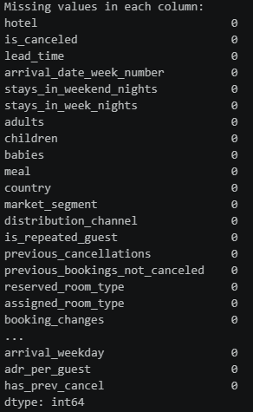


1
Check Data Set / No missing Values / Check Target variables
More experience reliably means more pay — up to a point, after which it plateaus.
2021 Salary Survey — Key Points
4

Slide 10
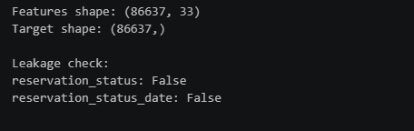


2
Pre-processing / Split / Data Conversion
Separate the target from the features
Remove columns that can reveal the final booking outcome
Check the results
Training 80/20
More experience reliably means more pay — up to a point, after which it plateaus.
2021 Salary Survey — Key Points
4

Slide 11
3
Classification Model
-Logistic Regression
-Decision Tree
-Random Forest
-Extra Trees
-SGD Classifier
More experience reliably means more pay — up to a point, after which it plateaus.
2021 Salary Survey — Key Points
4

Slide 12
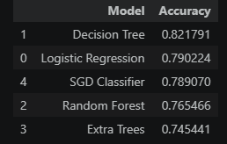
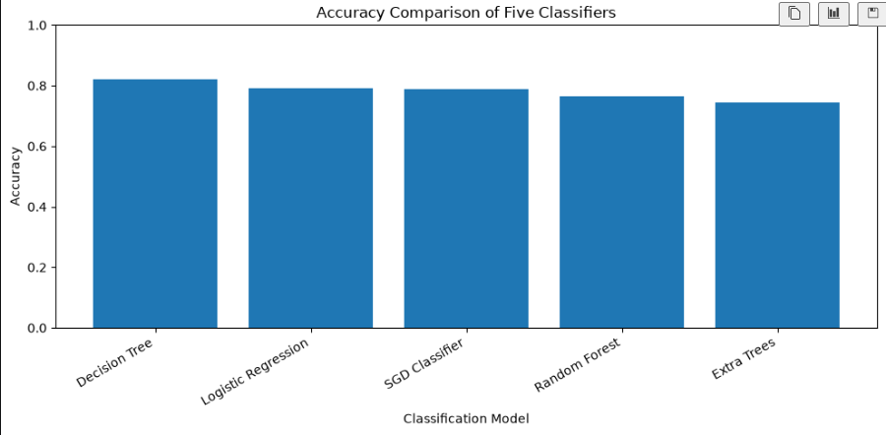
3
Accuracy comparison
More experience reliably means more pay — up to a point, after which it plateaus.
2021 Salary Survey — Key Points
4

Slide 13
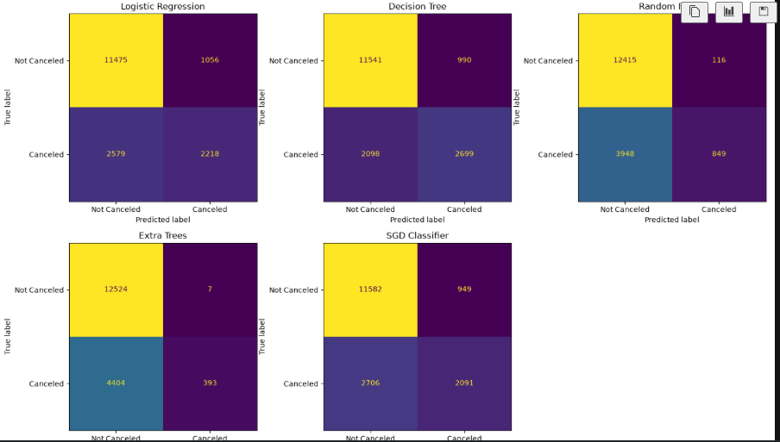
4
Confusion Matrix
More experience reliably means more pay — up to a point, after which it plateaus.
2021 Salary Survey — Key Points
4

Slide 14
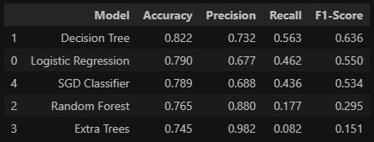
4
Evaluate precision, recall, and F1-score
More experience reliably means more pay — up to a point, after which it plateaus.
2021 Salary Survey — Key Points
4

Slide 15
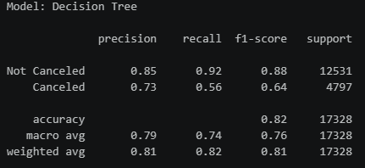
4
View the detailed classification report
More experience reliably means more pay — up to a point, after which it plateaus.
2021 Salary Survey — Key Points
4

Slide 16
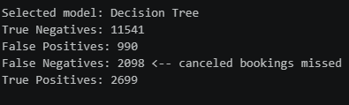
4
Display the confusion matrix counts for the selected model
More experience reliably means more pay — up to a point, after which it plateaus.
2021 Salary Survey — Key Points
4

Slide 17
5
Conclusion
BEST PERFORMING CLASSIFICATION MODEL
The model with the highest F1-score is Decision Tree.
Accuracy: 0.822
Precision: 0.732
Recall: 0.563
F1-score: 0.636
2. CANCELED BOOKINGS THAT THE MODEL MISSED
Correctly predicted non-canceled bookings: 11541
Non-canceled bookings incorrectly flagged: 990
Canceled bookings missed by the model: 2098
Correctly predicted canceled bookings: 2699
More experience reliably means more pay — up to a point, after which it plateaus.
2021 Salary Survey — Key Points
4

